Slide 1
ITP171
IT Fundamentals and Project
2018 S1

Slide 2
Your Module Leader
Ms Tan AiLian
Email: tan_ai_lian@nyp.edu.sg
Office number: 6550 0616
Location: L.624

Slide 3
About ITP171
MODULE LEARNING OUTCOMES
Explain the various concepts of IT hardware, software and different technologies used in IT infrastructure
Demonstrate how to apply basic web design concepts and tools to create a business website.
Develop a good understanding of the design thinking approach and apply relevant design methods/tools at various stages to create solutions that are innovative and human-centric.
Plan and execute a project as a team and deliver the solutions according to requirements

Slide 4
ITP171 Module Topics
Topics
Introduction to hardware, software and Internet
Introduction to HTML, CSS, Dreamweaver, Photoshop
Information Security
Enterprise IT – Server, Storage, BCM, Information Systems Architecture
IT Hot Topics – IoT, Big Data, Cloud
Design Thinking Skills
Business Proposal Development

Slide 5
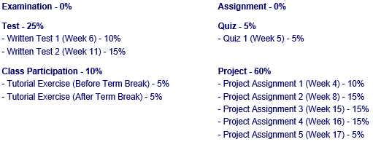
ITP171 Mode of Assessment
Total Assessment %: 100 %

Slide 6
Why is this module important?
Study module -40%
Project work – 60%
  (artefacts / product/ concepts)
High credit points module (8 credit points)
  high impact on GPA score
High GPA (full point 4.0)
  High chance to pursuit a degree, apply for scholarship or get a good pay job

Slide 7
Project Theme
Option 1:
How might we use IT to create a Better Singapore ?
(In term of Health care, Transport, Education or Lifestyle)
http://www.straitstimes.com/politics/imagining-the-future
Option 2:
Free theme that related to IOT, Infocomm and Security

Slide 8
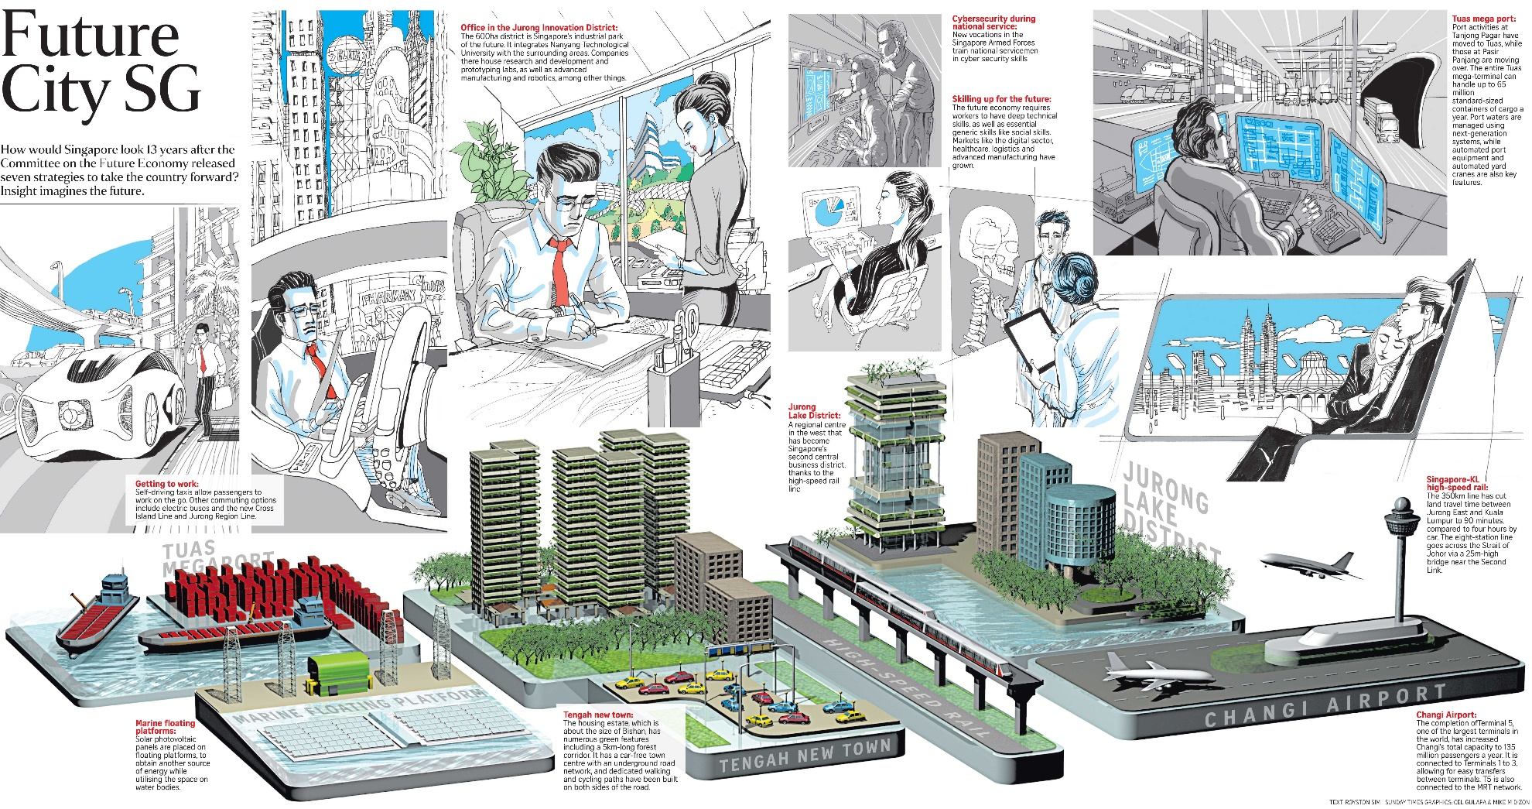
Project Theme

Slide 9





How we do Design Thinking?
Human Centered Research
Iterative Prototype
Define challenge
Creative Ideation
Evaluate
Source : NUS, ISS
Notes:
Process is not linear – iterative at any point. E.g. can go back to users at any time to seek feedback

Slide 10
Your attendance and rules
Attendance for all Lecture (1hr) / Lab (5hrs) /Tutorial (2hrs) sessions are compulsory
If student failed to achieve 75% attendance, student may face grade capped (Max D).
If you were to be on MC, clock your MC in SIT school admin and attendance system
Be on time, students who were to be late may be marked as absent for entire lab session
Strictly follow the time printed on your timetable
E.g class starts at 1010AM, you come at 1020, you are late for 10Min
Notes:
Minus MC hours, Grace period (10Min in timeable)

Slide 11
Other information
http://www.nyp.edu.sg
HOME > Current Students
Academic Matters
  Download Student Handbook
  Find out about ATTENDANCE policy

Slide 12
Think about this?
Is study important in Singapore?
http://img.sgag.sg/posts/2015/01/613_large_Screen_Shot_2015-01-21_at_10.23.36_pm.jpg?1425922696

Slide 13

Introduction - A World of Computers
Computers are everywhere

Slide 14
Networks and the Internet
People use the Internet for a variety of reasons:
Communicate
Research and Access Information
Shop
Bank and Invest
Online Trading
Entertainment
Download Videos
Share Information
Web Application

Slide 15







What Happens When You Shop @ Amazon
Wha.. So cheap.. Ddie die must buy
Bye bye bye…

Slide 16









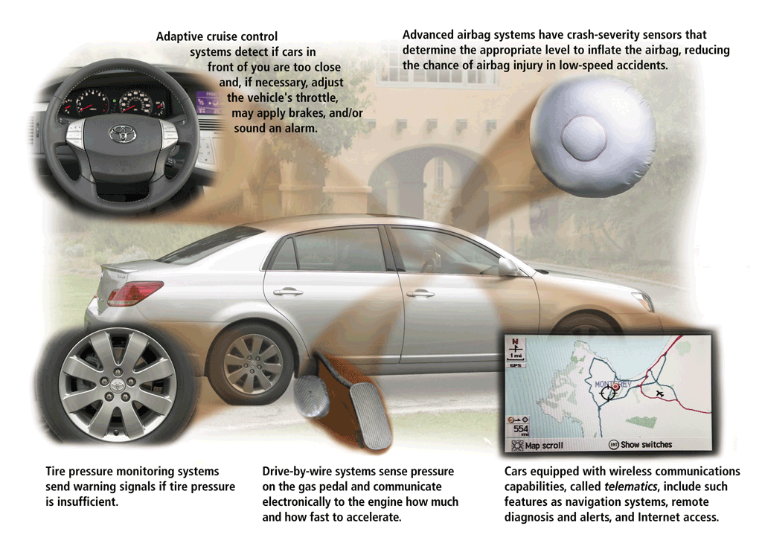
When It Arrives @ Amazon

Slide 17
What Did You Assume/Trust
Really directed to Amazon.com ?
When you submit, orders will be processed and fulfilled?
That the Internet is always up and running?
Treat IT like electricity and water
Security
Servers/Software
Green Computing
Cloud

Slide 18
Pillars of IT
Hardware
Software
Data
People
Procedures

Slide 19
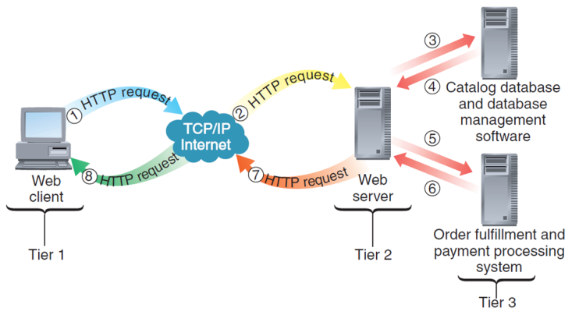
Your Journey….

Slide 20
Conclusion
The request and delivery of information involves many ‘people’ that need to work together
Through this course, we will meet each of this different technologies that will have influence
Notes:
Conclusion to course, lecture, et al.

